Slide 1
Phase - 3
Phase 3. Tableau Dashboard
Use Tableau to create dashboard (deliverable 3)
Dashboard should have 3+ graphs
One Pie Chart
One Bar Graph
One Table
Show examples of creating Calculated Fields.
Show examples of creating Filters.
Show examples of using filter actions based on selection on graph.
Show examples of using Formatting.

Slide 2
Phase - 3
Steps followed in the creation of Phase 3:
First and Foremost, all the normalised data done in phase 2 is loaded in tableau desktop.
Then, we have connected all the tables together.
By default, the connection will be live we’ve changed it to Extract.

Slide 3
Phase - 3
Charts Preparation:
Pie Chart:
In this chart, “Host”, “Test Series Year”, “Test Number” & “Innings” are used as Filters and “Venue” is used as both “colour” Marks and “Label” Marks which helps us show different types of venues using different colours and Label mark helps us to identify which colour represents which venue. We have then used “Host” & “Test Series Year” for “Details” Marks as well which will show us the country of the host by year.
Bar Chart:
To create the Bar chart, we used “Highest Scorer” in Columns and “Runs by highest scorer” (as SUM) in Rows. This will create the bars representing all the players. Further, we have used “Test Series Year”, “Test Number” & “Innings” as Filters using which we can view specific year, test number & innings according to our requirement. Further, we have used “Highest Scorer” in “Colour” Marks which will help us identify each player uniquely with different colours assigned to them and used “Team” in “Detail” Marks to show which player represents which team.

Slide 4
Phase - 3
Tree Map:
In this chart, “Test Series Year”, “Test Number” & “Innings” are used as Filters using which we can view specific year, test number & innings according to our requirement. Further, we have used “Wickets by Best Bowler” (as SUM) for both “Size” & “Colour” Marks. Size indicates the size of a tree block according to the wickets and colour shade represents the wickets from highest to lowest. Both “Team” & “Best Bowler” is used in “Label” Marks to display the team and best bowler’s name.
Table:
Here, to create a table, we have put “Test Series Year”, “Man of the Match”, “Winner” & “Team Total” in Rows. Further, we used “Test Series Year”, “Test Number” & “Innings” as Filters using which we can view specific year, test number & innings according to our requirement.

Slide 5
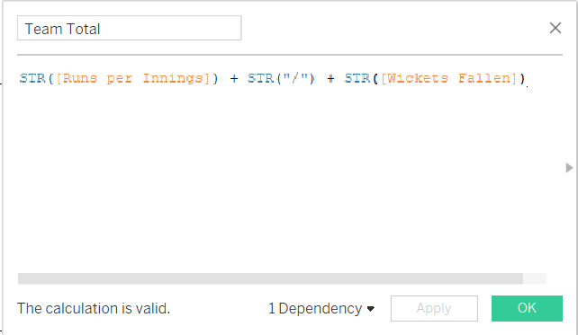
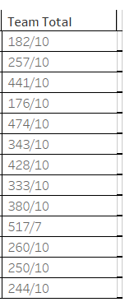
Phase - 3
Example of Creating Calculated Fields:
Here, we have created calculated field for “Team Total” to show team runs and wickets together in a same column. Example:
The above Calculated Field will give you the following result.

Slide 6
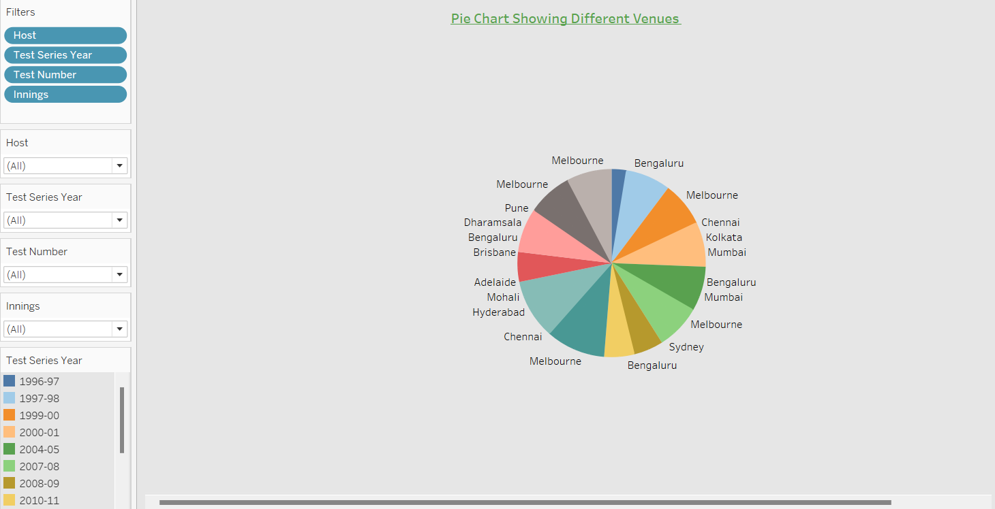
Phase - 3
Example of Creating Filters:
We have used filters in all the charts prepared as it is one of the important aspects of creating a functional chart. For Example:
Pie Chart: We have created below filters for pie chart.

Slide 7
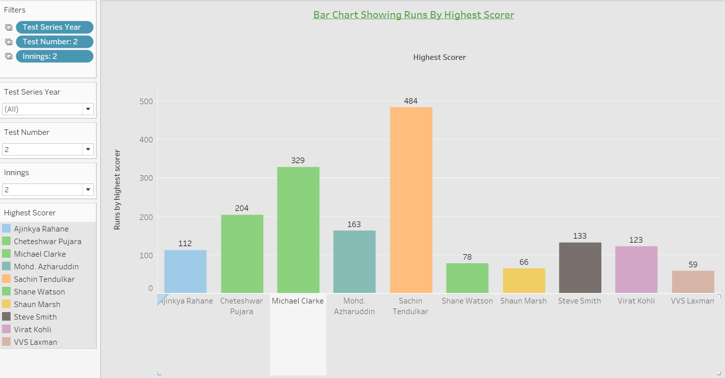
Phase - 3
Bar Chart: We have created below filters for Bar chart.

Slide 8
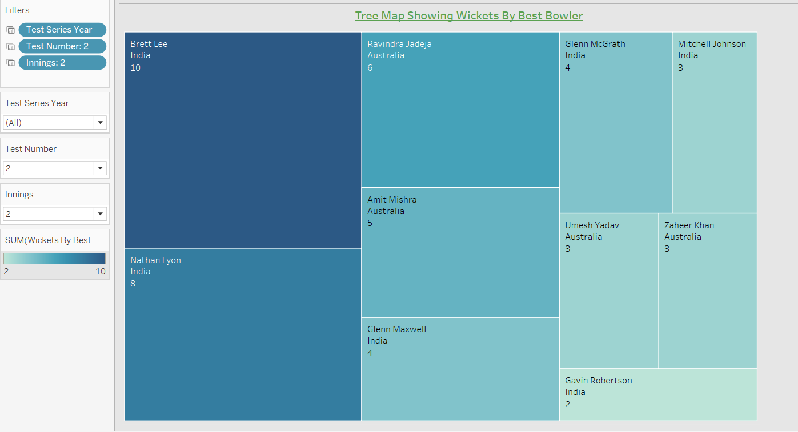
Phase - 3
Tree Map: We have created below filters for Tree Map.

Slide 9
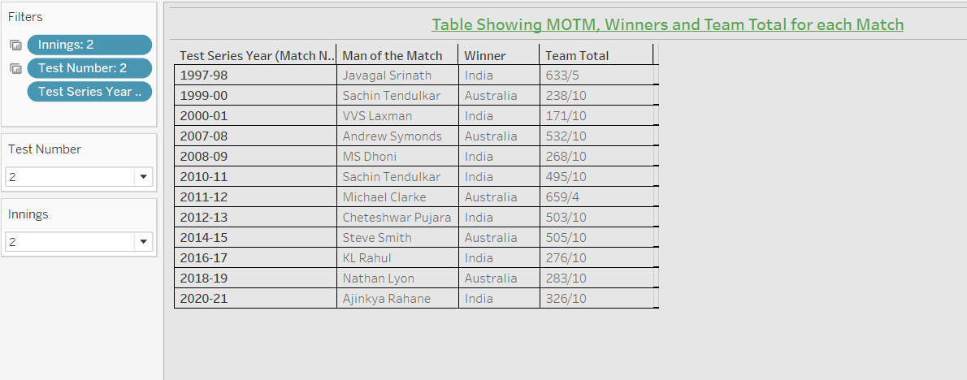
Phase - 3
Table: We have created below filters for Table.

Slide 10
Phase - 3
Example of Filter Actions:
Filter actions send information between worksheets. Typically, a filter action sends information from a selected mark to another sheet showing related information.
Here, we have used “Test series year” Filter for Bar chart and Tree Map.
“Test Number” for Bar chart, Tree Map and Table.
And “Innings” also for Bar chart, Tree Map and Table.

Slide 11
Phase - 3
Example of using Formatting:
We can format settings for fonts, alignment, shading, borders, lines and tooltips at the worksheet level. We have used formatting for all the charts we have created.
Example: for all the charts we have used colour formatting along with different font and colour for the title of the charts. We have even formatted the size of some charts according to the needs Example: Pie chart.

Slide 12
Phase - 3
Creating a Dashboard:
Finally, a Dashboard is created using all the charts we have prepared.
Pie Chart
Bar Chart
Tree Map
Table
The above charts are inserted in the dashboard and we have kept 4 filters to apply in the dashboard namely “Host”, “Test Series Year”, “Test Number” & “Innings”.
“Host” Filter is applied for Pie chart.
“Test Series Year” Filter is applied for Bar chart and Tree Map.
“Test Number” Filter is applied for Bar chart, Tree Map and Table.
And “Innings” Filter is also applied for Bar chart, Tree Map and Table.

Slide 13
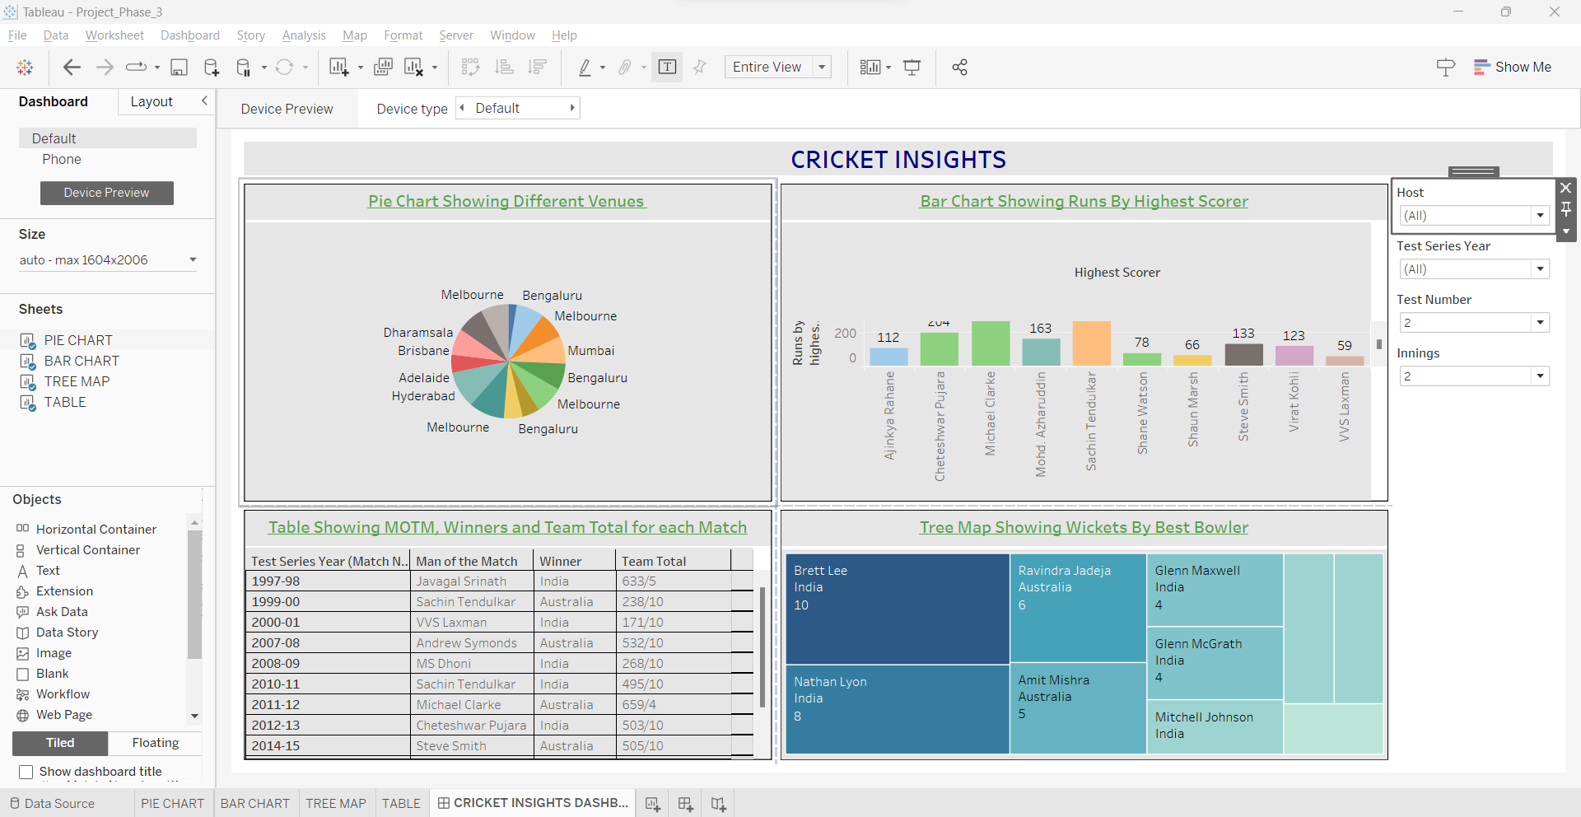
Phase - 3
Final Dashboard:

